Slide 1
Library Management System With Sms Autoreply
Presented By :
[ Neha Chaugule]

Slide 2
INDEX
Project Overview
Scope
Modules
Development Tools
Pros & Cons
Applications

Slide 3
PROJECT OVERVIEW
This Library Management System can be used to maintain records of user details like registering books, checking balance penalty amount etc.
This system not only works from admin side but also from user side.
This application also works by SMS. Users can directly send SMS to a particular phone no. with some predefined text and value. And he/she will get reply via SMS.

Slide 4
SCOPE
The Library Management System that is to be developed provides the members of the Library and employees of the library with books information, online blocking of books and many other facilities. library users can easily check the availability of any book that they need.

Slide 5
MODULES
Admin
Registration
Manage User
Manage Books
View Orders
Subscriptions
Payments
Offline Helpline using SMS
User
Login
Profile
Browse books
View Orders
Pay late fee
View payments
Offline Helpline using SMS

Slide 6

DEVELOPMENT TOOLS
ANDROID STUDIO
Android Studio is the official[7] integrated development environment (IDE) for Google's Android operating system, built on JetBrains' IntelliJ IDEA software and designed specifically for Android development.
Features:
1. Rich Layout Editor
2. Android Virtual Device
3. Quick Fixes Suggestion

Slide 7
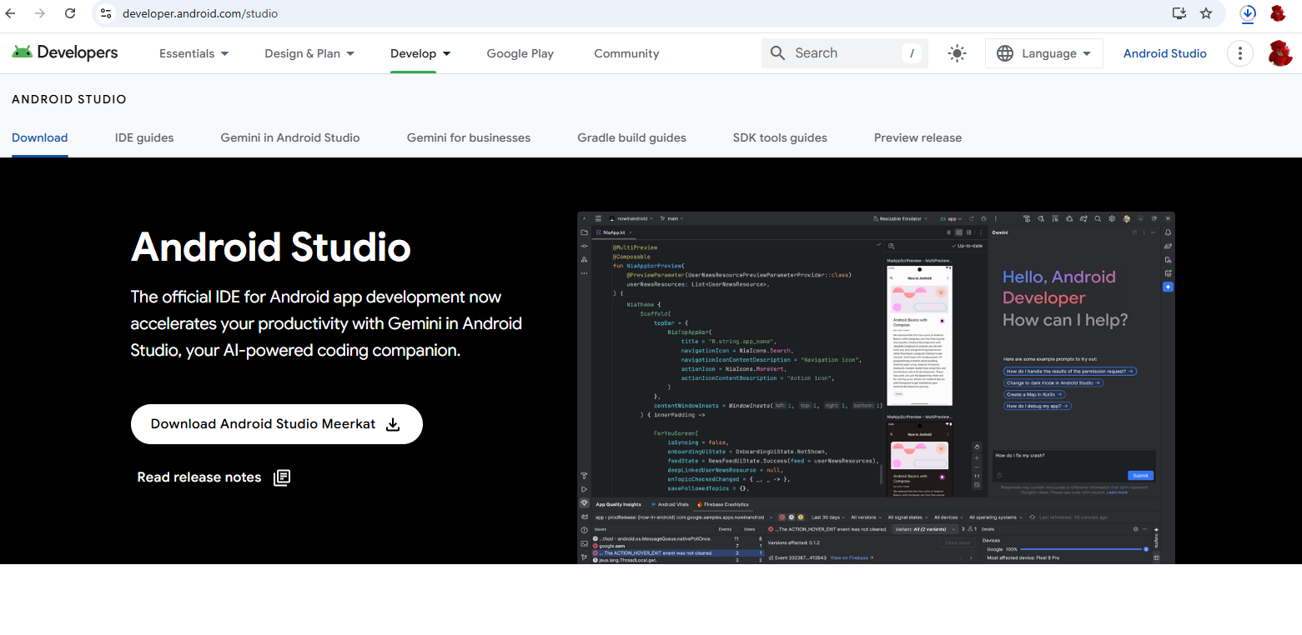
Download Android Studio
We can get Android Studio from Developers.Android.com : Visit Here

Slide 8

DEVELOPMENT TOOLS
MICROSOFT SQL SERVER
Microsoft SQL Server is a relational database management system developed by Microsoft. As a database server, it is a software product with the primary function of storing and retrieving data as requested by other. Microsoft markets at least a dozen different editions of Microsoft SQL Server, aimed at different audiences and for workloads.
Features:
1. Least Vulnerable 2. Advanced Analytics 3. Easy-to-Use

Slide 9
Download Microsoft SQL Server
We can get SQL Server from AndroidDeveloper.com : Visit Here

Slide 10
PROS & CONS
Pros
User can check for books without visiting library.
They can get reminders on their phone.
For SMS Autoreply users don’t need active internet connection.
Cons
This application requires active internet connection.
User need to put correct data or else it behaves abnormally.

Slide 11
APPLICATIONS
A library management system reduces the cost of management.

Slide 12
REFERENCES
Microsoft Developer Network (MSDN): http://msdn2.microsoft.com/en-us/default.aspx: This is a valuable online resource, and is a must for any developer using Microsoft tools.
http://www.asp.net/: This is the official Microsoft ASP.NET web site. It has a lot of: tutorials, training videos, and sample projects.

Slide 13
THANK YOU !!!

